Slide 1
A taxonomy of memory networks

Slide 2
Content
Motivation
Memory structure analysis for dynamic neural network
Memory structure analysis
Memory network taxonomy
Mapping from architecture to task types
Experiment
Research plan

Slide 3
Motivation: memory for sequence learning
Sequence learning category:
sequence prediction
Sequence recognition
Sequence generation
Sequence decision making

Slide 4
Motivation: memory for sequence learning
In artificial intelligence and machine learning, there is the need to develop learning systems for different types of memory
Associative memory,
e.g. Hopfield network (static memory)
how ✅ what ❌ when ❌
Notes:
associative memory knows how to stored some patterns, but it does not know what information needs to be stored and when to store or retrieve it.
In other words, associative memory just stores all the patterns presented to it, it
does not know how to bring information from the past to the current time; secondly, due to
the update operation of hopfield network, it may not even reach a minimum before inputs are
changed.

Slide 5
Motivation: memory for sequence learning
For sequence learning, memory preserves in some form (by storing past samples or using a state model) the information from the past.
Dynamic memory
TDNN, GAMMA neural model, RNN
LSTM, GRU, neural stack, end-to-end memory network, Neural Turing machine, Pointer network, DNC, Attention model …
Notes:
associative memory knows how to stored some patterns, but it does not know what information needs to be stored and when to store or retrieve it.
In other words, associative memory just stores all the patterns presented to it, it
does not know how to bring information from the past to the current time; secondly, due to
the update operation of hopfield network, it may not even reach a minimum before inputs are
changed.

Slide 6
Motivation: memory analysis
Difficulties of Memory analysis:
1 a very abstract concept
2 the memory requirements for a specific task are implicit
3 spatio temporal concept.

Slide 7
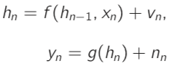
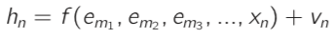
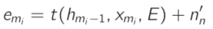
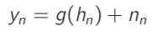
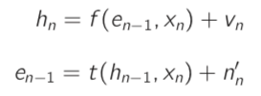
Motivation: memory analysis
Common data generating system:
Proposed data generating system:
Relationship:
Example: “John was born and raised in China. He went to the UK to study after 18 years old and now lives in the United States. John’s mother language is –".
Notes:
In other words, associative memory just stores all the patterns presented to it, it
does not know how to bring information from the past to the current time; secondly, due to
the update operation of hopfield network, it may not even reach a minimum before inputs are
changed.

Slide 8
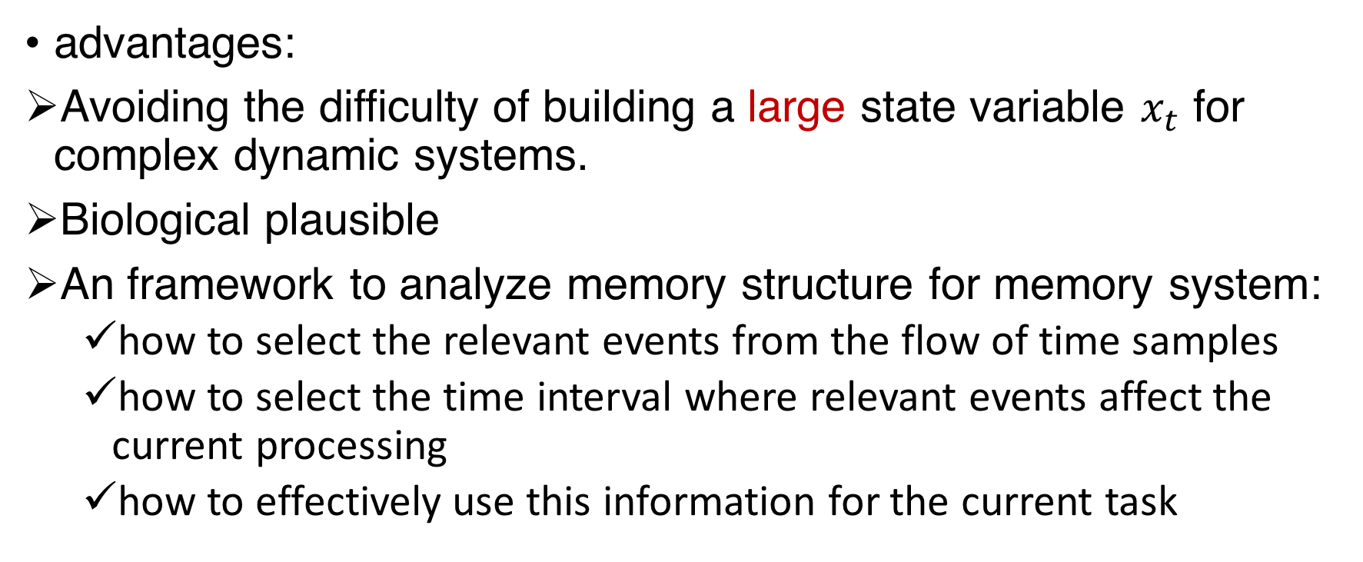
Motivation: memory analysis
advantages:
Avoiding the difficulty of building a large state variable $x_{t}$ for complex dynamic systems.
Biological plausible
An framework to analyze memory structure for memory system:
how to select the relevant events from the flow of time samples
how to select the time interval where relevant events affect the current processing
how to effectively use this information for the current task
Notes:
The working mechanism of the underlying dynamic system is more like the way human solving with a sequence learning problem (When human make decisions or predictions, they usually ignore useless intermediate samples and recall relevant past events).
. When the problem is posed in this way we immediately can see three fundamental steps in any memory system
extracting useful events emi from the time series and storing them for future use.
: at each time step, the relevant events needs to be selected from the past stored events set.
how to stored least number of events to solve a specific task.

Slide 9
Motivation: memory analysis
Research goal:
Task1: Investigate the characteristics of memory implemented by each architecture from "how many events can be stored" perspective.
Task2: Employ the knowledge gained from the different characteristics of these memory structures to help users select the most parsimonious type of memory network given the problem at hand.

Slide 10
Content
Motivation
Memory structure analysis for dynamic neural network
Memory structure analysis
Memory network taxonomy
Mapping from architecture to task types
Experiment
Research plan

Slide 11
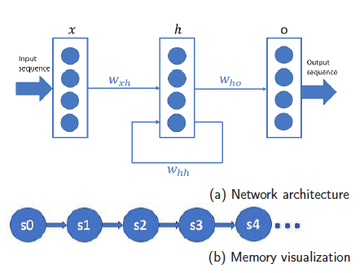
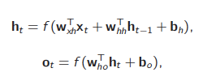
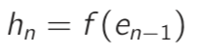
Memory structure analysis: 1 vanilla RNN
Notes:
This memory mixed all the past events in its hidden state. It can not recover these distinct events from the hidden state. Hence, the state can also be seen as one single compound event which is updated each time step,

Slide 12
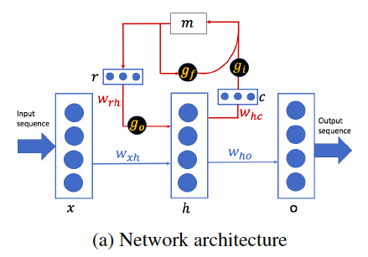
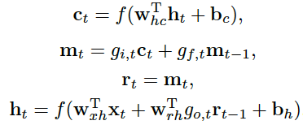
Memory structure analysis: 2 LSTM

Slide 13
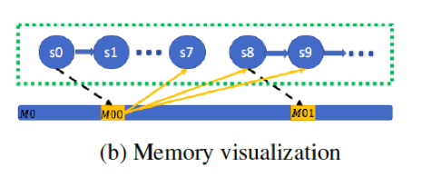
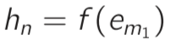
Memory structure analysis: 2 LSTM
Notes:
It was the first memory network that had to address the problem of how to store and retrieve information from an external source to improve performance (through gating networks).
In other words, LSTM is capable of extracting a useful event at a specific time and storing it in an external memory which won’t be affected by the intermediate irrelevant information
By constructing this short path between long-term memory and the current state, LSTM performs much better than vRNN for sequences that skip intermediate values of time dependencies. This long-term memory can also be seen as the event extracted from the input time series
Note that here the useful event happened at time m1 other than n − 1 as in
vRNN(2–3).
In other words, LSTM is capable of extracting a useful event at a specific time and
storing it in an external memory which won’t be affected by the intermediate
irrelevant information.

Slide 14
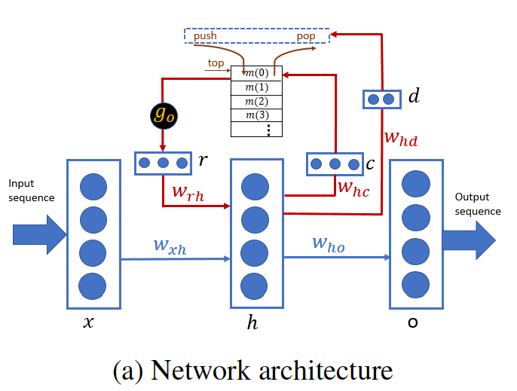
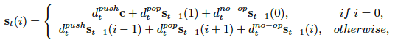
Memory structure analysis: 3 Neural stack

Slide 15
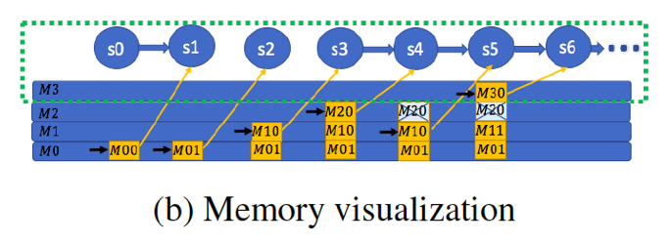
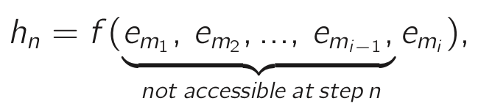
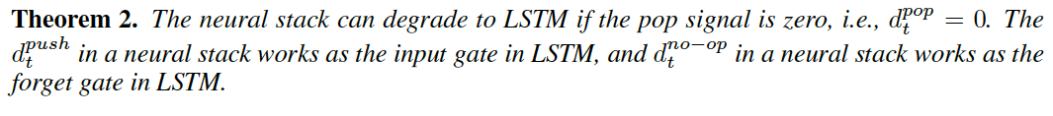
Memory structure analysis: 3 Neural stack
Notes:
where emi is the event stored on the top of stack. Compared Eq.(2–8) and Eq.(2–12), LSTM can be seen as a special case of the neural stack
In contrast to LSTM, a neural stack can store more than one useful event in its external memory bank.

Slide 16
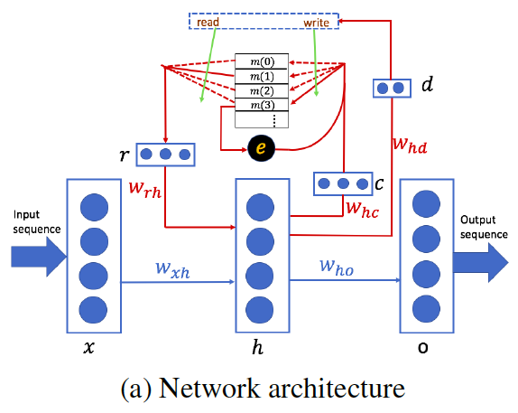
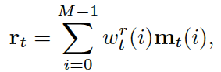
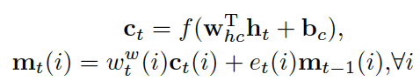
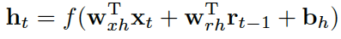
Memory structure analysis: 4 Neural RAM

Slide 17
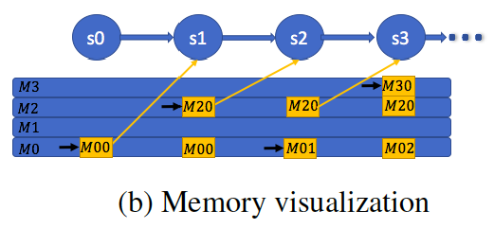
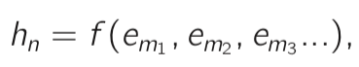
Memory structure analysis: 4 Neural RAM
Notes:
The RAM network can be seen as an improvement of the neural stack in the sense that all the contents in the memory bank can be read from and written to multiple times. Moreover, no requirements exist for the order of storing, updating and accessing the memory elements.
It is not hard to see that neural RAM is more powerful compared to all other architectures.

Slide 18
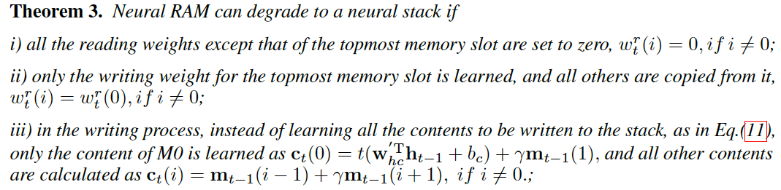

Slide 19
Content
Motivation
Memory structure analysis for dynamic neural network
Memory structure analysis
Memory network taxonomy
Mapping from architecture to task types
Experiment
Research plan

Slide 20
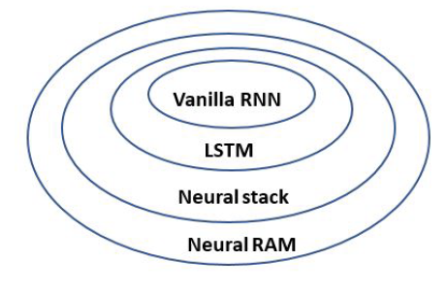
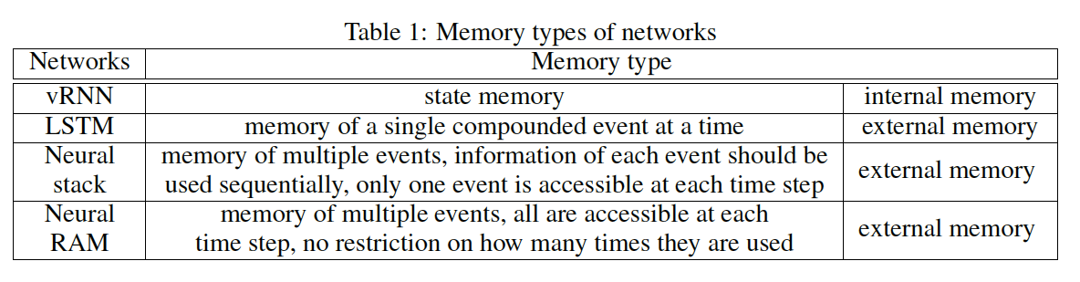
Neural network taxonomy
vRNN class: IRNN, the highway network
LSTM class: GRU and the peephole network
The neural stack class: the architecture in Sun (1993); Sun et al. (2017); Joulin & Mikolov (2015); Grefenstette et al. (2015),
neural RAM class: NTM, DNC, enhanced LSTM…
Notes:
Some classes are named after a typical model.

Slide 21
Content
Motivation
Research plan
Memory structure analysis for dynamic neural network
Memory structure analysis
Memory network taxonomy
Mapping from architecture to task types
Experiment

Slide 22
MAPPING FROM NETWORK TYPES TO TASK TYPES
Counting
Counting with inference
Reversing
Repeat copying

Slide 23
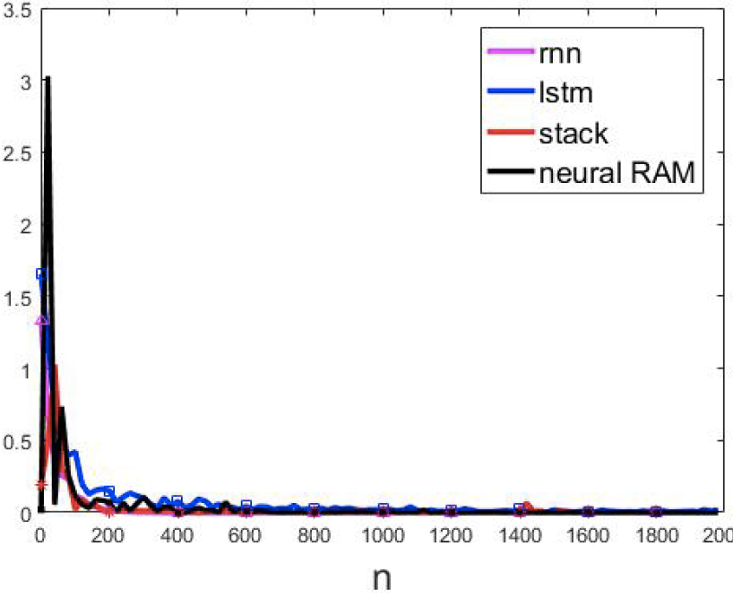
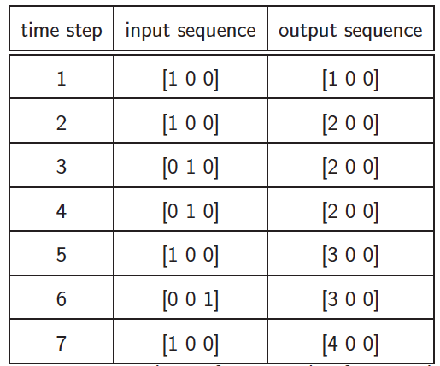
Counting:
aaabcaa 1233345
In neural RAM, memory depth M = 3.
In LSTM, neural stack, neural RAM, memory width N = 3
The number of input, hidden, output neurons are 3.

Slide 24
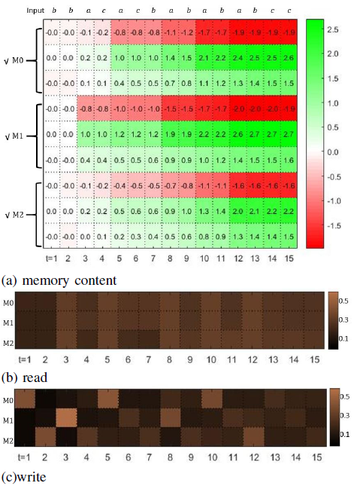
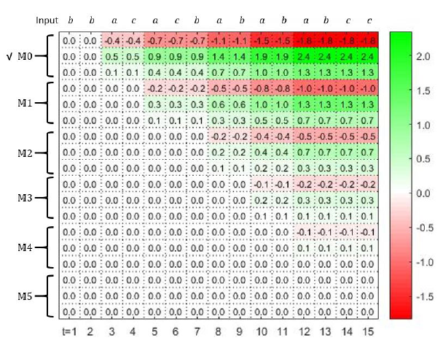
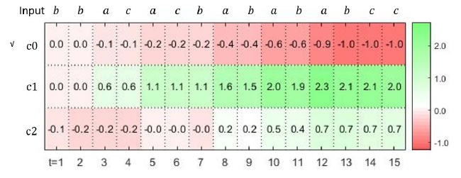
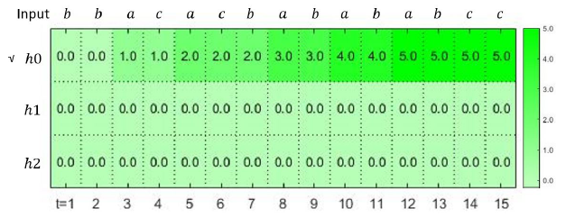
Counting:
Neural RAM
Neural Stack
LSTM
RNN

Slide 25
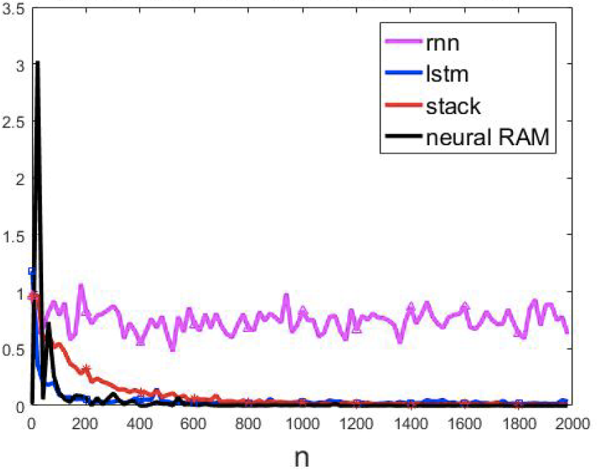
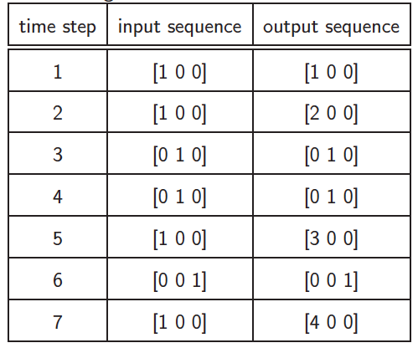
Counting with interference
aaabcaa 123bc45

Slide 26
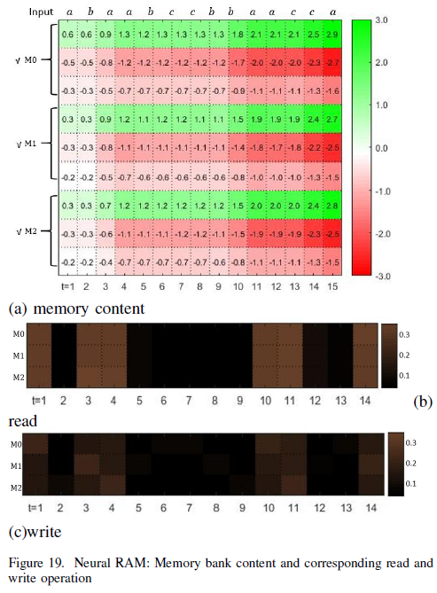
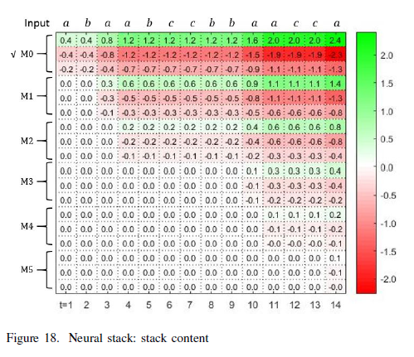
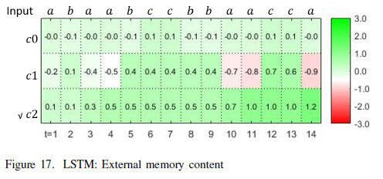
Counting with interference
Neural RAM
Neural stack
LSTM

Slide 27
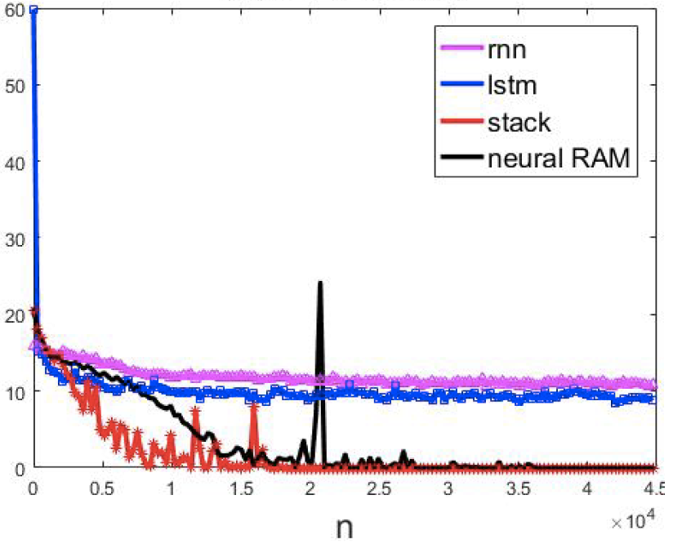
Reversing
adabcA----- ------ cbada
In neural RAM, memory depth M=16.
The length of read and write vectors are 16.
In LSTM, neural stack, neural RAM, memory width N = 16
The number of input, hidden and output neurons are 6, 64, 6.

Slide 28
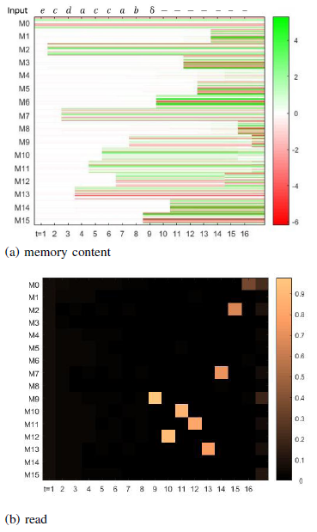
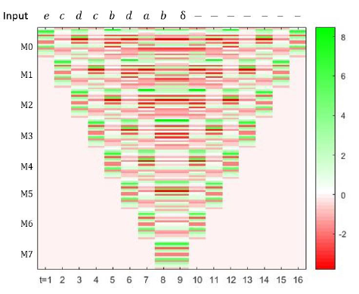
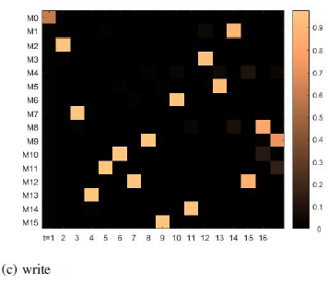
Reversing
Neural RAM
Neural stack

Slide 29
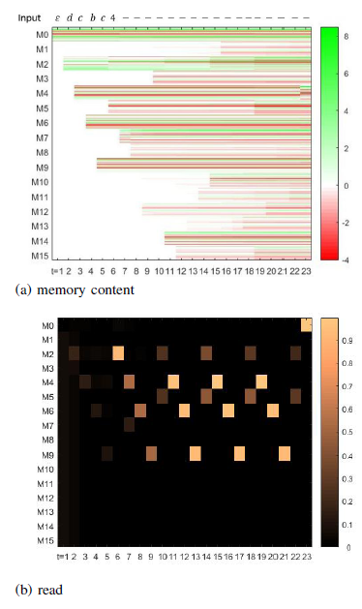
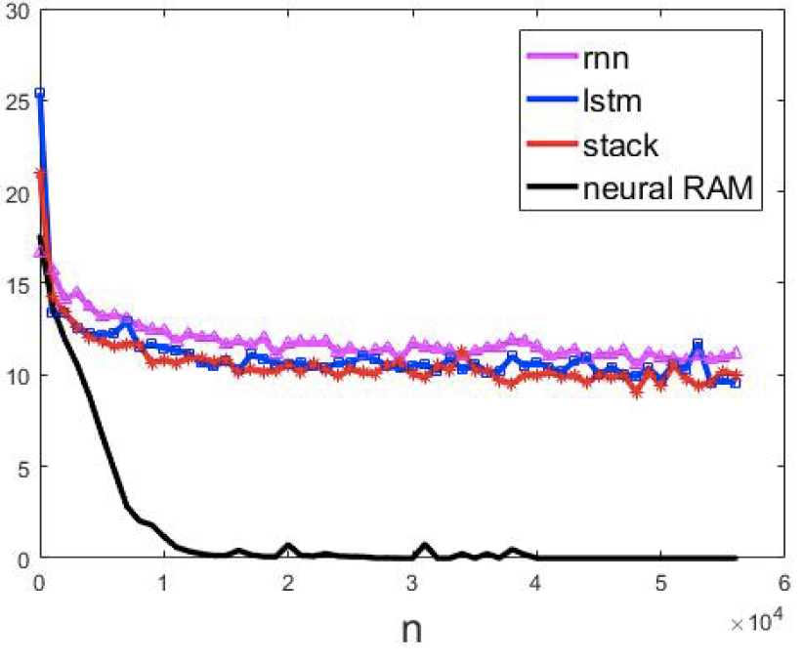
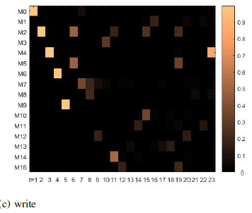
Repeat copying
adabc3 ------adabcadabcadabc
Neural RAM

Slide 30
Content
Motivation
Memory structure analysis for dynamic neural network
Memory structure analysis
Memory network taxonomy
Mapping from architecture to task types
Experiment
Research plan

Slide 31
Sentiment analysis
Outlandish premise that rates low on plausibility and unfortunately also struggles feebly to raise laughs or interest. Only Hawn’s well-known charm allows it to skate by on very thin ice. Goldie’s gotta be a contender for an actress who’s done so much in her career with very little quality material at her disposal
“I absolutely loved this movie. I bought it as soon as I could find a copy of it. This movie had so much emotion, and felt so real, I could really sympathize with the characters. Every time I watch it, the ending makes me cry. I can really identify with Busy Phillip’s character, and how I would feel if the same thing had happened to me. I think that all high schools should show this movie, maybe it will keep people from wanting to do the same thing. I recommend this movie to everybody and anybody. Especially those who have been affected by any school shooting. It truly is one of the greatest movies of all time.

Slide 32
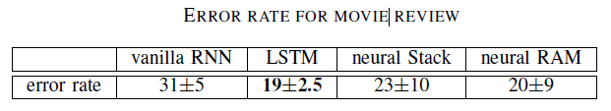
Word encoding: pretrained model: GloVe, 400,000 word vectors, each with a dimensionality of 50.
Dataset: lmdb movie review: 12500 positive reviews and 12500 negative reviews.
The output is [1, 0] for the positive text and [0, 1] for the negative text.
For all architectures, the number of input, hidden and output neurons are 50, 64, 2.
In LSTM, neural stack and neural RAM, memory width N = 64
In neural RAM, the memory depth M=64. The number of read and write head are 4 and 1.
The results are average of 20 runs with random initializations.

Slide 33
Question answering
1 Daniel went to the kitchen.
2 Daniel journeyed to the hallway.
3 Mary went back to the garden.
4 Daniel picked up the apple there.
5 Sandra went to the office.
6 Sandra travelled to the bedroom.
7 Mary got the football there.
8 Sandra grabbed the milk there.
9 Mary left the football.
10 Daniel left the apple.
11 Where is the football? garden 9 3
12 Daniel got the apple there.
13 Sandra dropped the milk.
14 Where is the milk? bedroom 13 6
15 Mary picked up the football there.
16 John moved to the bathroom.
17 Where is the milk? bedroom 13 6
18 Mary moved to the bedroom.
19 Sandra went to the garden.
20 Where is the milk? bedroom 13 6
21 Daniel discarded the apple.
22 Daniel went to the bathroom.
23 Where is the apple? hallway 21 2

Slide 34
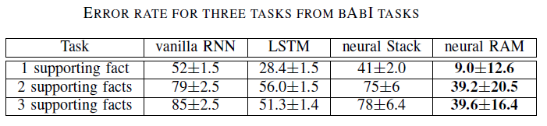
For all the four network architectures, the number of input, hidden and output neurons are 150, 64, 150.
In LSTM, neural stack and neural RAM, memory width N = 64
In neural RAM, the memory depth M=64.
The number of read and write head are 4 and 1.
The results are average of 20 runs with random initializations.
Training questions: 10,000 questions

Slide 35
Content
Motivation
Memory structure analysis for dynamic neural network
Memory structure analysis
Memory network taxonomy
Mapping from architecture to task types
Experiment
Research plan

Slide 36
Research plan
Task1: Define intrinsic properties of memory and investigate the characteristics of memory implemented by each architecture from "how many events can be stored" perspective.
Task2: Employ the knowledge gained from the different characteristics of these memory structures to help users select the most parsimonious type of memory network given the problem at hand.
Task3: Develop an memory augmented neural network for sequence prediction, with application on question answering problem. May,2019
Task4: Develop an memory augmented neural network for sequence decision making, with application on Super Mario video game. Mar,2020

Slide 37
Thank you

